Slide 1

CONSTITUIONAL LAW & ETHICS
Faculty of Law

Slide 2
CONSTITUTIONAL law & ETHICS
UNIT 3- Cyber Law
Faculty of Law

Slide 3
CYBER LAWS
Introduction
‘Cyber’ is a prefix used to describe a person, thing or idea as part of the computer and information age.
Need for Cyber laws.
Cyber law encompasses:
Cyber crimes
Electronic and digital signatures
Intellectual property
Data protection and privacy

Slide 4
CYBER LAWS
Introduction
‘Cyber crime’ is not defined in Information Technology Act 2000.
Any illegal behavior committed by means of, or in relation to a computer system or network, including such crimes as illegal possession, offering or distributing information by means of computer system or network, or threatening the security of computer systems and the data processed by them.

Slide 5
CYBER LAWS
Introduction
Cyber laws in India
The Information Technology Act 2000 (amended in 2008).
The main purpose of the Act is to provide legal recognition to electronic commerce and to facilitate filing of electronic records with the Government
The Act essentially deals with the following issues:
Legal Recognition of Electronic Documents
Legal Recognition of Digital Signatures
Offenses and Contraventions
Justice Dispensation Systems for cyber crimes.

Slide 6
CYBER LAWS
Identity Theft
Also called Email spoofing
Formation of e-mail messages by impersonating correspondent identity.
Origin different from which it actually originates.
Example: Creating accounts on social media impersonating someone else.
66C of I.T Act - Electronic signature or other identity theft like using others’ password or electronic signature etc. Punishment is three years imprisonment or fine of one lakh rupees or both.

Slide 7
CYBER LAWS
Hacking
Section 66, IT Act, 2002.
It is also denoted as ‘Unauthorized Access’.
But IT Act gives the terms unauthorized access a wider meaning and should not be interchanged with Hacking.
Includes Internet time theft. (Gaining access to internet without another person’s knowledge)
Example:
Bangladesh Bank Heist(2016)
Facebook (2018)

Slide 8
CYBER LAWS
Denied Service Attack
Act by which user of a website or service is denied from using the server or website.
Offenders aim the web server of the websites and flow a large number of requests to that server.
Causes the use of maximum bandwidth of the website.
Website slows down or crashes and remains unavailable to authorized users.
Instance: In 2000, 15 year old hacker known as ‘Mafiaboy’ took down the servers of CNN, Dell, E-trade, eBay and Yahoo!

Slide 9
CYBER LAWS
Mail Bombing
User sends large number of email to target address.
Email address(in case of Individual) or mail server(in case of company or service provider) crashes.
Gives the impression of Denial of service.

Slide 10
CYBER LAWS
Virus Attack
A type of malware
Viruses are self duplicating computer programs which mount themselves without the users approval.
When executed replicates by implanting replicas of itself into other computer programs data files or the boot sector of the hard drive.
Reproduction proceeds
Affected zones are said to be infected.

Slide 11
CYBER LAWS
Effect of Virus attack
Stealing hard disk space or CPU time
Retrieving private information
Corrupting data
Displaying radical or funny mails on the user’s display
Spamming their links or logging their keystrokes.
Trojan horse
Law
Section 43
Section 66

Slide 12
CYBER LAWS
Cyber warfare
Cyber war in simple term means the use of computer technology to disrupt the activities of a state or organization by disabling financial and organizational systems through stealing or altering classified data to undermine networks, websites and services via the Internet through computer viruses, Denial-of-Service attacks, etc.
All cyber wars are cyber crimes but not all cyber crimes are cyber wars.

Slide 13
CYBER LAWS
Cyber warfare
Methods
Espionage and National security breaches
Malwares, Denial of service attacks, Hacking etc.
If any cyber crime is politically motivated, which may destroy data or even cause physical damage to infrastructure of a specific country, it may be considered an act of cyber war.
It consists of nation-states’ using cyberspace to achieve the same general ends they pursue through the use of conventional military force.

Slide 14
CYBER LAWS
Cyber terrorism
Cyberterrorism essentially consists of using computer technology to engage in terrorism.
Cyber terrorism is different from crime as cyber terrorism is of international concern whereas cyber crime is of domestic concern.
Common forms of terrorist attacks
Dispersed denial of service attacks
Hate websites and hate mails
Attack on delicate computer networks

Slide 15
CYBER LAWS
Cyber terrorism
Example : Osama Binladen, the LITE attack on America’s Army deployment system during Iraq War.
Law
Section 66 F

Slide 16
CYBER LAWS
Phishing
Is a cyber crime in which a target is contacted through electronic means by someone posing as a legitimate institution to lure individuals in to providing sensitive data such as personally identifiable information, banking and credit card details, passwords etc.
Methods- fake websites, spoof free Wi-Fi access points, pop-ups etc.
Laws
Section 43
Section 66, 66A, 66C, 66D

Slide 17
CYBER LAWS
Bandwidth theft/ Hotlinking
Bandwidth refers to the amount of data transferred from a web site to a user's computer. When you view a web page, you are using that site's bandwidth to display the files. Since web hosts charge based on the amount of data transferred, bandwidth is an issue. If a site is over its monthly bandwidth, it's billed for the extra data or taken offline.
Bandwidth theft or "hotlinking" is direct linking to a web site's files (images, video, etc.).
Law
Section 43

Slide 18
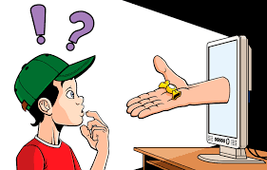
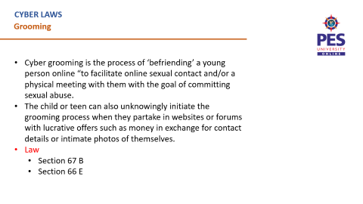
CYBER LAWS
Grooming

Slide 19
CYBER LAWS
Grooming
Cyber grooming is the process of ‘befriending’ a young person online “to facilitate online sexual contact and/or a physical meeting with them with the goal of committing sexual abuse.
The child or teen can also unknowingly initiate the grooming process when they partake in websites or forums with lucrative offers such as money in exchange for contact details or intimate photos of themselves.
Law
Section 67 B
Section 66 E

Slide 20
CYBER LAWS
Cyber Stalking
Section 66 A Punishment for sending offensive messages through communication service, etc.
(Introduced vide ITAA 2008):
Any person who sends, by means of a computer resource or a communication device,-
any information that is grossly offensive or has menacing character; or
any information which he knows to be false, but for the purpose of causing annoyance, inconvenience, danger, obstruction, insult, injury, criminal intimidation, enmity, hatred, or ill will, persistently makes by making use of such computer resource or a communication device;

Slide 21
CYBER LAWS
Cyber Stalking
any electronic mail or electronic mail message for the purpose of causing annoyance or inconvenience or to deceive or to mislead the addressee or recipient about the origin of such messages shall be punishable with imprisonment for a term which may extend to three years and with fine.

Slide 22
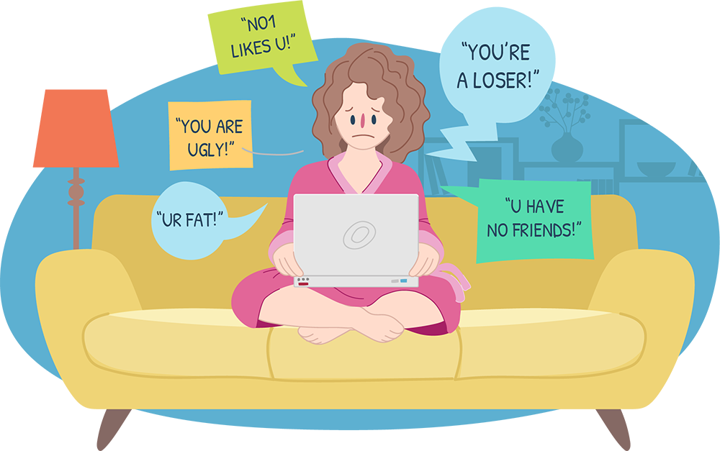
CYBER LAWS
Harassment

Slide 23
CYBER LAWS
Harassment
Cyberbullying is bullying with the use of digital technologies. It can take place on social media, messaging platforms, gaming platforms and mobile phones. It is a repeated behaviour, aimed at scaring, angering or shaming those who are targeted. Examples include:
spreading lies about or posting embarrassing photos of someone on social media
sending hurtful messages or threats via messaging platforms
impersonating someone and sending mean messages to others on their behalf.

Slide 24
CYBER LAWS
Harassment
Law
Section 66 A
Shreya Singhal v. U.O.I
This is a landmark judgment, where section 66A of the Information Technology Act, 2000 was repealed.

Slide 25
CYBER LAWS
Obscenity
A very offensive or sexually shocking word, photos, videos etc.
Section 67- Publishing of information which is obscene in electronic form
Section 67 A- Punishment for publishing or transmitting of material containing sexually explicit act, etc.
Section 67 B- Punishment for publishing or transmitting of material depicting children in sexually explicit act, etc. in electronic form.

Slide 26
CYBER LAWS
Morphing
To gradually change, or change someone or something, from one thing to another.
Morphing is not recognized as an offence under IPC or The I.T Act.
Laws that may be applicable if morphed pictures are transmitted or published
Section- 66 E, 67, 67 A, 67 B of I.T Act.
Section- 509, 354, 500 of IPC.
Indecent Representation of Women (Prevention) Act.

Slide 27
CYBER LAWS
Child abuse
Child is anyone under the age of 18.
Online child abuse most commonly includes grooming, live streaming, consuming child sexual abuse material, and coercing and blackmailing children for sexual purposes.
Online child abuse often occurs across multiple jurisdictions, with victims and offenders often in different countries.
Abuse may be sexual, physical, emotional and also includes sexual exploitation.

Slide 28
CYBER LAWS
Child Abuse
Section 67 B Punishment for publishing or transmitting of material depicting children in sexually explicit act, etc. in electronic form
publishes or transmits or causes to be published or transmitted material.
depicting children in obscene or indecent or sexually explicit manner through images, videos etc.
Cultivates, entices or induces children to online relationship.
facilitates abusing children online.
records in any electronic form own abuse or that of others pertaining to sexually explicit act with children.

Slide 29
CYBER LAWS
Prosecution
Section 46 - Power To Adjudicate
Sec 46 confers the power to adjudicate contravention under the Act to an officer not below the rank of Director to Government of India or equivalent officer of state.
Appointing Authority- Central Govt.
The Cyber Appellate Tribunal
Establishment- Central Govt.
The Central Government in consultation with the Chief Justice of India selects the Chairperson and other members.
Section 62 - Appeal To High Court

Slide 30
CYBER LAWS
IP Regime
Intellectual property (IP) refers to creations of the mind, such as inventions; literary and artistic works; designs; and symbols, names and images used in commerce.
Why is IP protected by law?
Enable people to earn recognition.
Financial benefit.
Prevent misuse by third party .
Balance between the interests of innovators and the wider public interest.

Slide 31
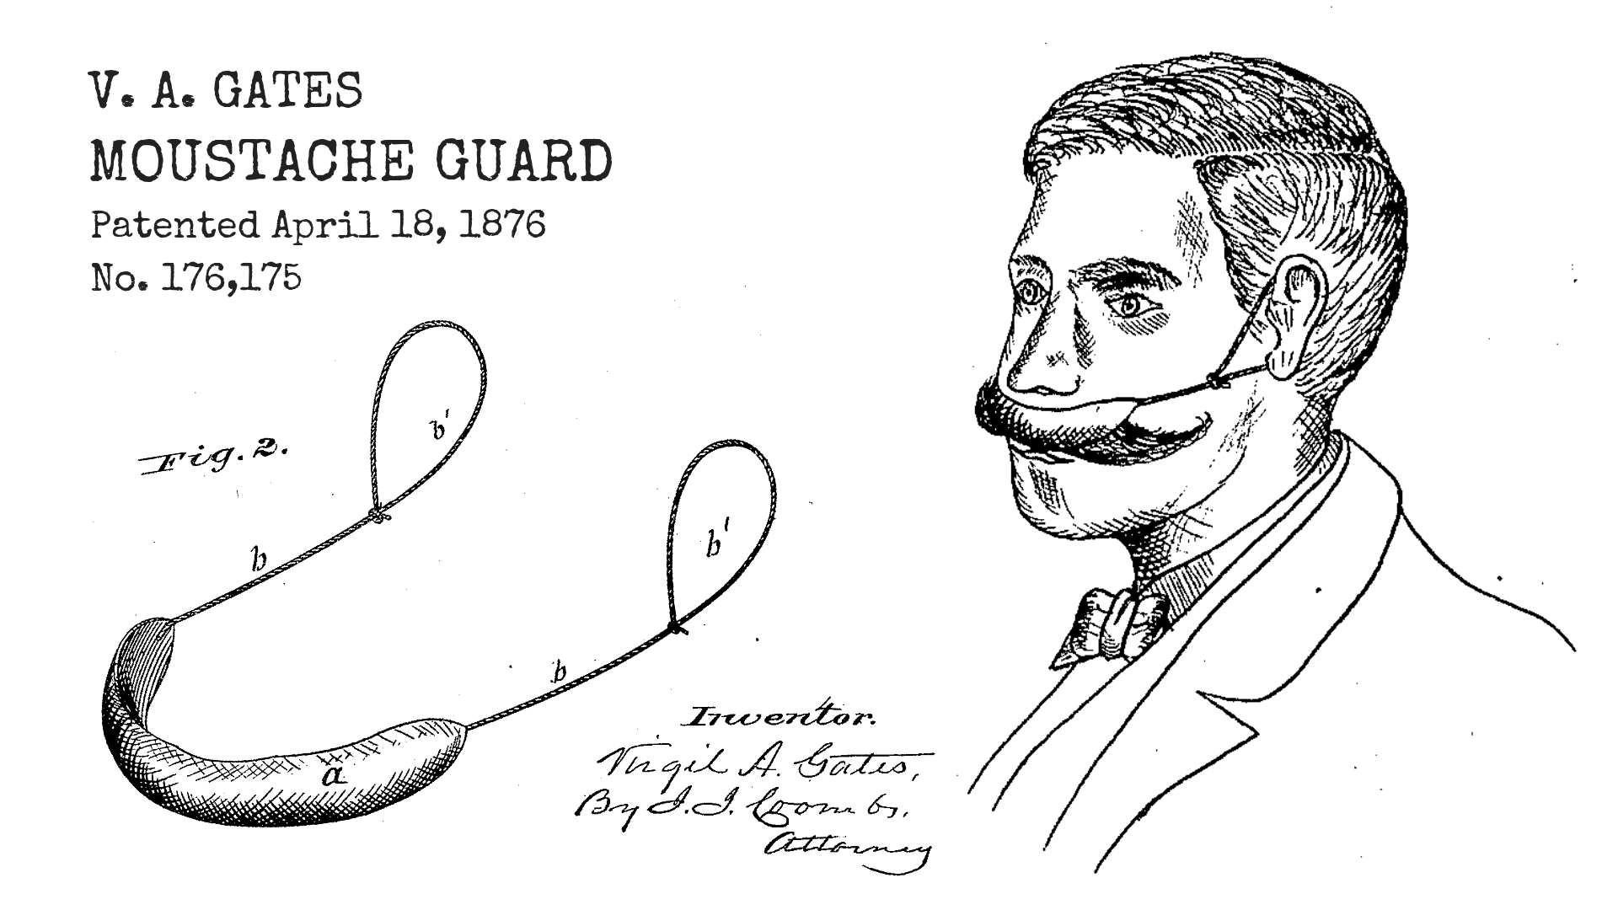
CYBER LAWS
Patents

Slide 32
CYBER LAWS
Patents
A patent is an exclusive right granted for an invention, which is a product or a process that provides, in general, a new way of doing something, or offers a new technical solution to a problem.
How long does patent protection last?
Patent protection is granted for a period of 20 years from the filing date of the application.
Is a patent valid in every country?
No. Patents are territorial rights.
Indian Patents Act, 1970

Slide 33
CYBER LAWS
Patents
Infringement of a patent consists of the unauthorized making, importing, using, offering for sale or selling any patented invention within the India.
Remedies
A civil action can be initiated in a Court of Law.
Administrative remedy: The patent owner can reach The collector of customs and prohibit the entry of these goods into Indian market.
Civil remedies: Injunctions & Damages or accounts of profits

Slide 34
CYBER LAWS
Copyright
The exclusive and assignable legal right, given to the originator for a fixed number of years, to print, publish, perform, film, or record literary, artistic, or musical material.
Copyright law protects expressions of ideas rather than the ideas themselves.
Indian Copyright Act, 1957
Does copyright have to be registered?
No.

Slide 35
CYBER LAWS
Copyright
Infringement
Copyright Act of 1957.
Interlocutory Injunctions
Pecuniary Remedies
Anton Pillar Orders
Mareva Injunction

Slide 36
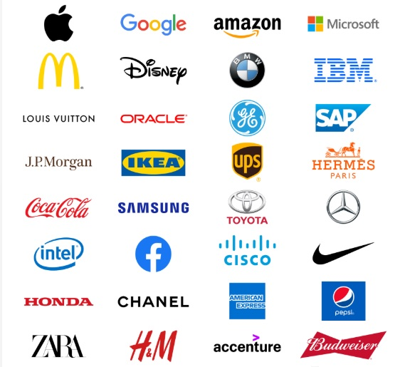
CYBER LAWS
Trademark

Slide 37
CYBER LAWS
Trademark
A trademark is a word, phrase, symbol, and/or design that identifies and distinguishes the source of the goods of one party from those of others.
Trade Marks Act, 1999
Infringement and Passing off
Injunction
Damages
delivery or removal of the products that have been infringed
Criminal remedies- Imprisonment, Penalty

Slide 38
CYBER LAWS
Geographical Indications
Geographical indications means any indications which define the goods as originating in the territory of a country or a region or locality in that territory, provided a given quality reputation or other characteristics of the product are attributable to its geographical origin.
Example: Basmati Rice, Darjeeling Tea Mysore Pak

Slide 39
CYBER LAWS
Geographical Indications
The Geographical Indications of Goods (Registration and Protection) Act
Infringement
Injunction
Damages
Delivery of the infringing labels and indications containing products
Criminal remedies

Slide 40
CYBER LAWS
Industrial Design
It is one of the forms of IPR that protects the visual design of the object which is not purely utilized. It consists of the creation of features of shape, configuration, pattern, ornamentation or composition of lines or colours applied to any article in two or three-dimensional form or combination of one or more features.
Design protection deals with the outer appearance of an article, including decoration, lines, colours, shape, texture and materials.

Slide 41
CYBER LAWS
Industrial Design
Design Act of 2000
10 years
Infringement
Injunction
Damages
Criminal Prosecution

Slide 42
CYBER LAWS
Semiconductor Integrated Circuits Layout Design
"Semiconductor integrated circuit" means a product having transistors or other circuitry elements, which are inseparably formed on a semiconductor material or an insulating material or inside the semiconductor material and designed to perform an electronic circuitry function.
"Layout-design" means a layout of transistors, and other circuitry elements and includes lead wires connecting such elements and expressed in any manner in a semiconductor integrated circuit.

Slide 43
CYBER LAWS
Semiconductor Integrated Circuits Layout Design
Semiconductor Integrated Circuits Layout Designs Act, 2000
Infringement
No express mention of Civil remedies
But Injunction, damages, Accounts of profits may be claimed
Criminal remedies

